Slide 1
OOP part 3
Kia Babashahi Ashtiani

Slide 2
Outline
Primitive types and methods
Shadowing
Deep copy vs shallow copy
Nested classes
TDD : Test Driven Development
Unit tests

Slide 3
Primitive types as arguments
When sending a primitive type as method argument a copy of the content of the variable is sent to the method not itself.
This is not always the case with reference types.
You must be careful.

Slide 4
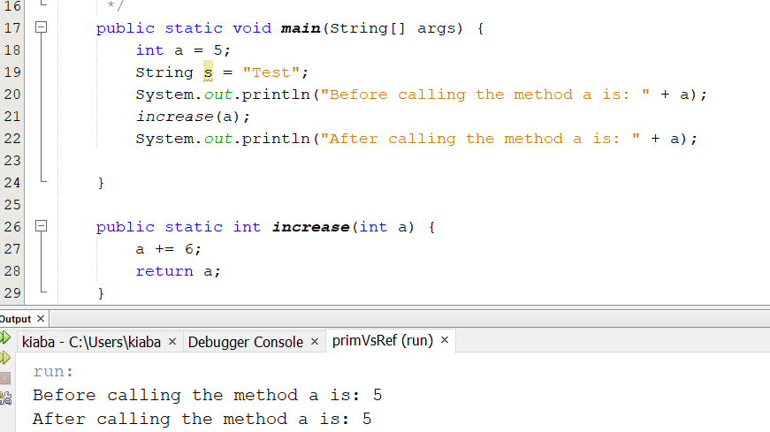
A copy is sent
The value of a remains unchanged.
This will not happen if you change reference types such as arrays.

Slide 5
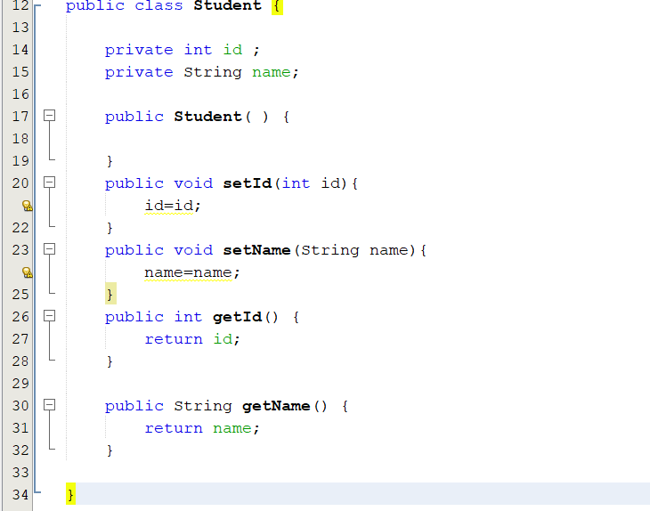
Shadowing example
Trying to set the id.
The parameter int id is sent but it has the same name as the field id.
id in the setId method is going to be local to its scope.
Same story with name,
Pay attention to the colors.
Technically the field id is not going to be updated.
Only the value id (the parameter) is gonna replace itself.
Same thing about name;

Slide 6
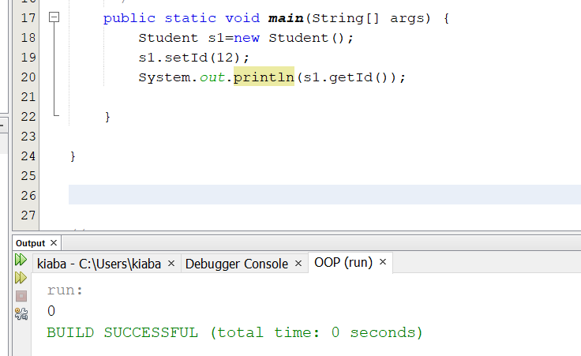
Main
12 is sent indeed. However, in the class, 12 (the id) is local to its scope and will only set 12=12;
The id which is a global variable is not going to change.
Since id was an int it was initialized to zero.
setId did not change the fields value. So it remains unchanged.

Slide 7
Shadowing
When the name of an argument of a method/constructor in a class is the same as one of its fields and you try to initialize the field with the argument with the same name.
The field will not be initialized.
  The compiler will not be able to distinguish which parameter are you referring to? The field or the argument?
We will use the keyword this to address this problem.

Slide 8
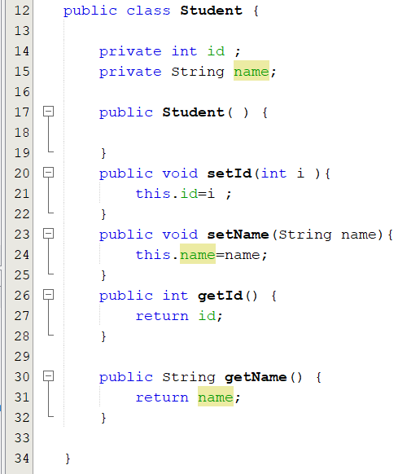
Notice the color change

Slide 9
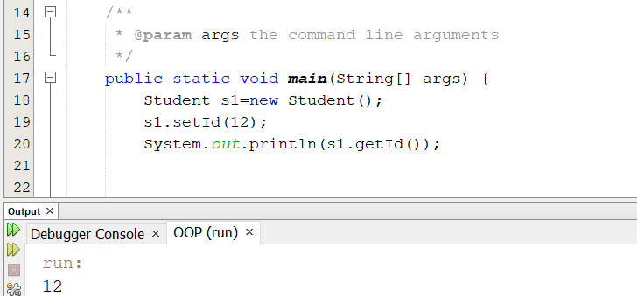

Slide 10
Nested objects
Consider the following example.
Let's imagine there are two classes in our program.
  Student with an id field and a name field and a teacherName field.
  Teacher with an id field and a name field and a field being an object of the student class. (Every teacher supervises a student)
How should we construct this?
Which class should be created first?
If you want to place a student in a teacher then the student should already exist right?

Slide 11
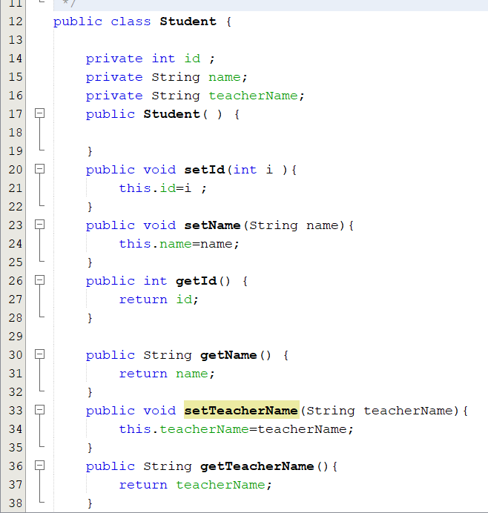
The student only stores the name of the teacher for now

Slide 12
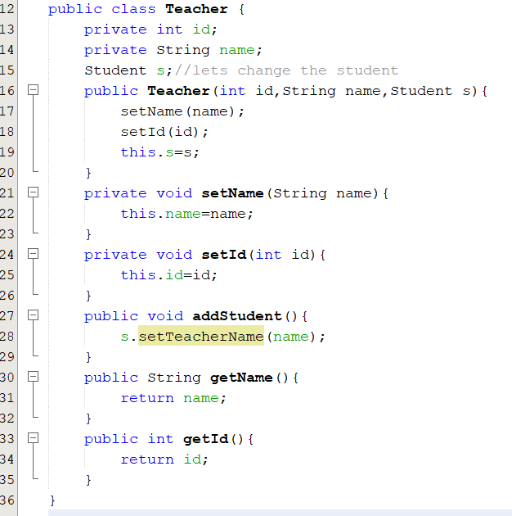
Teacher has a student object

Slide 13
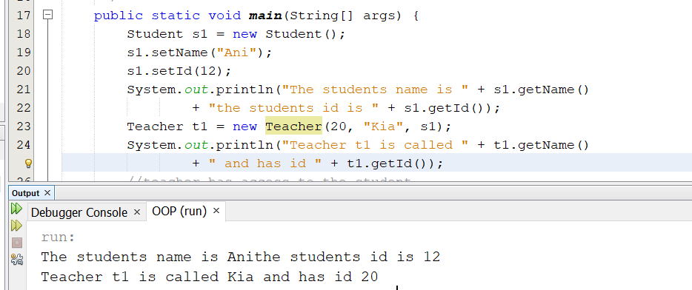
Calling and initializing using main

Slide 14
Reference calls
We are sending a student ( an object) to the constructor of our teacher class.
So the teacher has direct access to the student and not a copy of the student.
Hence, any change the teacher applies to the student might be preserved.
Take another look at the Teacher class.
  The teacher can set the field teacherName of a particular STUDENT.
  This is done via the setTeacherName method where the teacher registers a student as their student by writing their name as the teacherName attribute of the student class.
  The change is then preserved as the teacher is accessing the object directly not a copy of it.

Slide 15
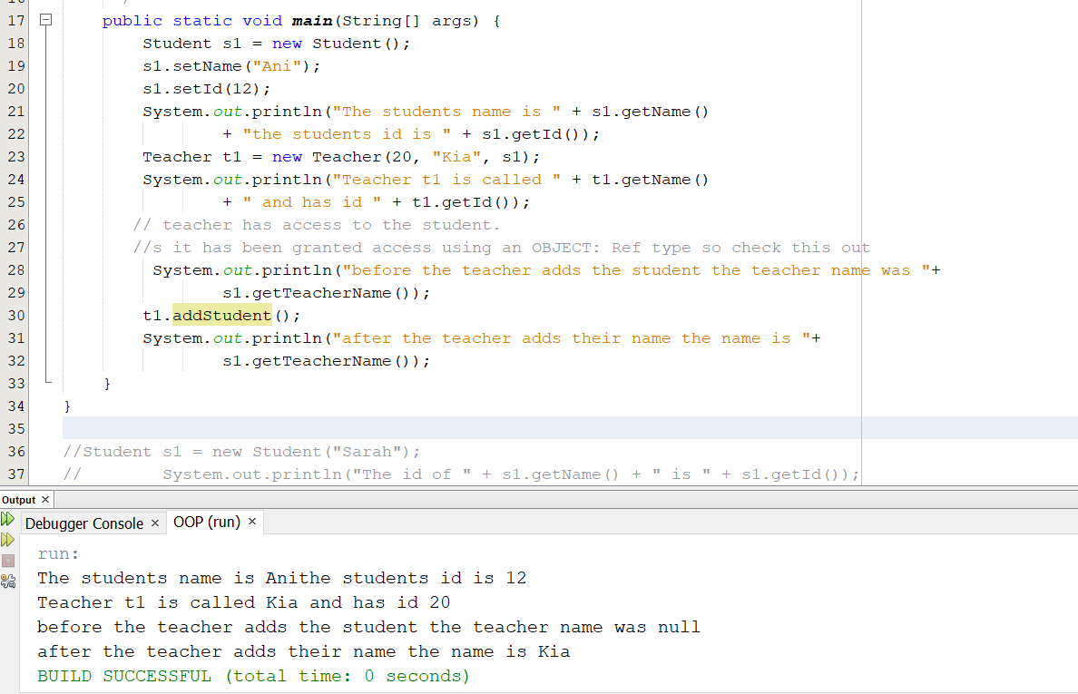
S1 will let t1 change its teacherName field.

Slide 16
Strings, AGAIN!
The class string is a final class.
Strings are immutable objects that after creation can not be changed. So you can not change the object, but you can change the reference to the object. W8 what?!! (see the next slide)
However, in a lot of the operations you have preformed on strings you have seen them change, right?! The pointers are changing actually not the objects themselves ☺
If two things become the same, a change in one will lead to the change in the other.
This is what happens when dealing with reference types.
Let's check strings out to make it clearer.

Slide 17
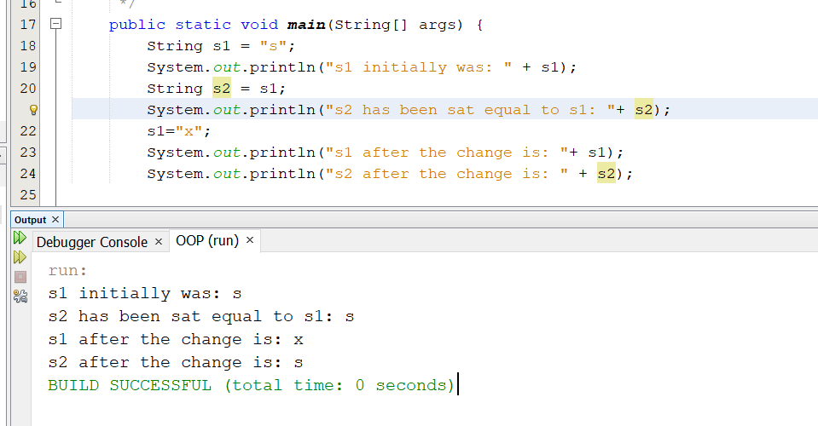
The pointer to “s” and the pointer to “x” have changed.

Slide 18
Heap space
Java allocates some of its memory to what is called the heap space.
This memory unit stores the initialized objects by the by the JVM .
When the JVM is called to run an application the heap is created, and its space might change.
When the heap is full garbage collection will start cleaning it up.
For more information click here.

Slide 19
Strings 2
There are two ways of creating strings :
  one is the way we did in the past
    Creates a string object in the constant string pool.
  Uses the string constructor to create a string object and put in the heap space

Slide 20
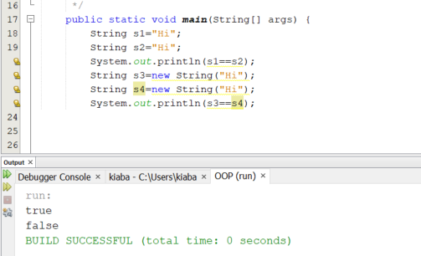
S3 and s4 are pointing to two different objects in the heap space.

Slide 21
Objects and Strings: Equals vs ==
We compare the equality of primitive types using ==
  2==2, 3!=3, 5.5== 5.5 , ‘a’==‘b’
Yet, when it comes to Strings and Objects. Another syntax should be used.
== is an operator that compares the address of the objects
The method equals is used to compare the content of the objects.

Slide 22
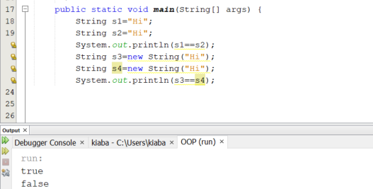
Equals vs ==

Slide 23
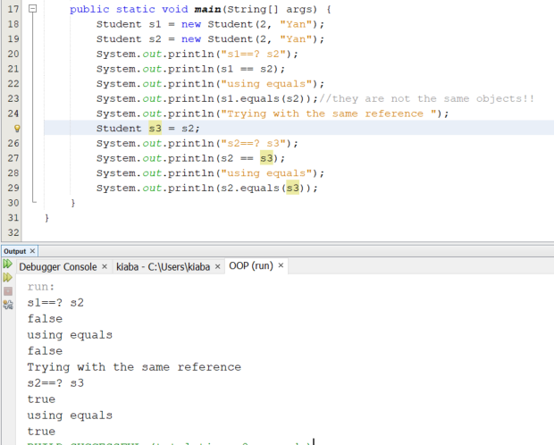
Equals for objects: NEVER use == to compare the value of two objects

